Slide 1
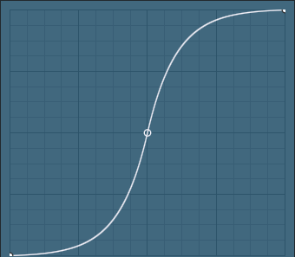
Waveshaping in the Web Audio API

Slide 2
WaveshaperNode
Waveshaping is implemented with WaveshaperNode
var distortion = context.createWaveShaper();
or
var distortion = new WaveShaperNode(context);
Must define a waveshaping curve
Float32Array of numbers describing the input/output characteristic curve
Array gets mapped to the range of inputs -1 to +1
Array must be at least two values
1st element is output for input -1 and below
Last element is output for input +1 and above
Interpolate all values in between
var curve= new Float32Array([-1, 1]);
distortion.curve = curve;
Oversample property defines if 'none', '2x' or '4x'oversampling is used.
Defaults to ‘none’

Slide 3
Clipper curves
var x,nSamples = 100,curve = new Float32Array(nSamples)
for (let i=0;i<nSamples;++i) {
x = 2*i/nSamples-1; // x goes from -1 to +1
if (Math.abs(x)>0.5) curve[i]=0.5*Math.sign(x)
else curve[i]=x
}

Slide 4
BitCrusher
Audio effect that produces distortion by reducing of the resolution or bandwidth of digital audio data
Lets reduce the resolution by decreasing the bit depth
1 bit audio → 2¹ levels for all samples, -0.5, +0.5
2 bit audio → 2² levels for all samples, -0.75, -0.25, 0.25, 0.75
3 bit audio → 2³ levels for all samples, …-0.375, -0.125, 0.125, 0.375,0.625,0.875
…
16 bit audio → 2¹⁶ levels for all samples, -1+2¹⁶ to 1-2¹⁶
Notes:
-3/4, -¼, ¼ ¾
-1 + 2^{-N}
(4-1)/4, (4-3)/4… ¼, 3/4

Slide 5
BitCrusher
var x,nSamples = 65536,curve = new Float32Array(nSamples);
var nLevels=Math.pow(2,nBits.value);
for (i=0;i<nSamples;++i) {
x = i*nLevels/nSamples; //x goes from 0 to 1
curve[i] = (2*Math.floor(x)+1)/nLevels-1;
}
Notes:
-3/4, -¼, ¼ ¾
-1 + 2^{-N}
(4-1)/4, (4-3)/4… ¼, 3/4

